Slide 1
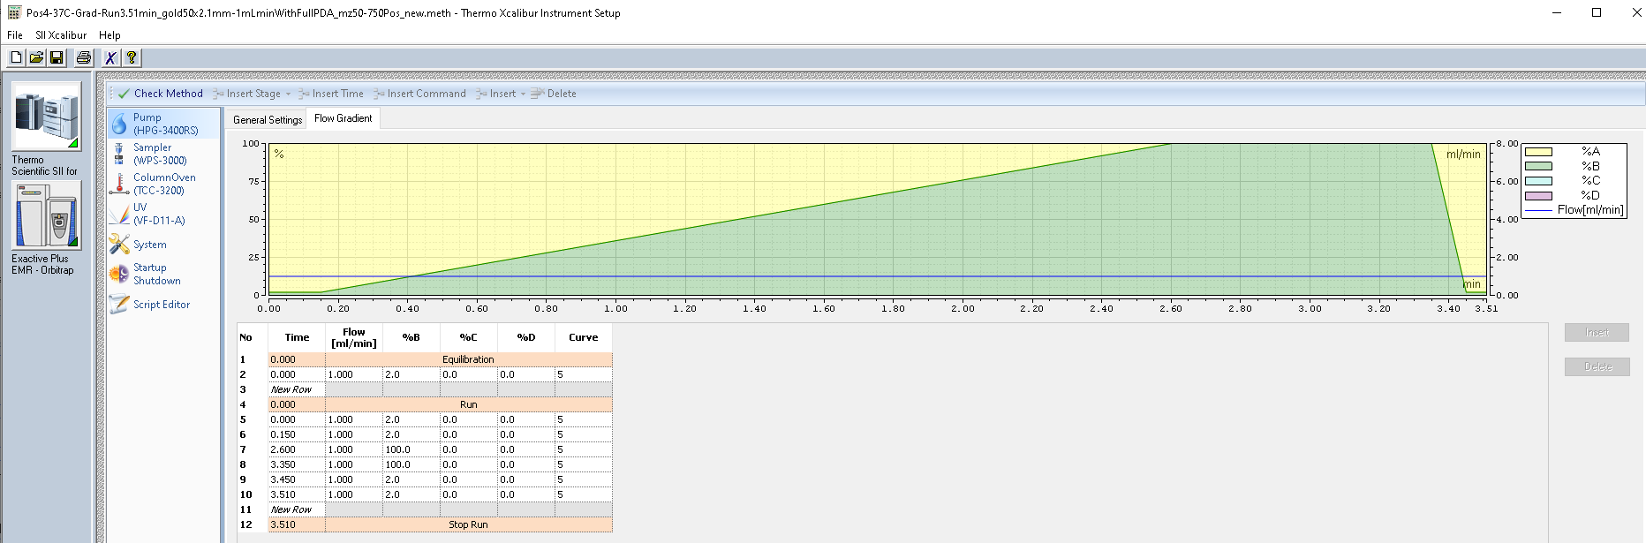
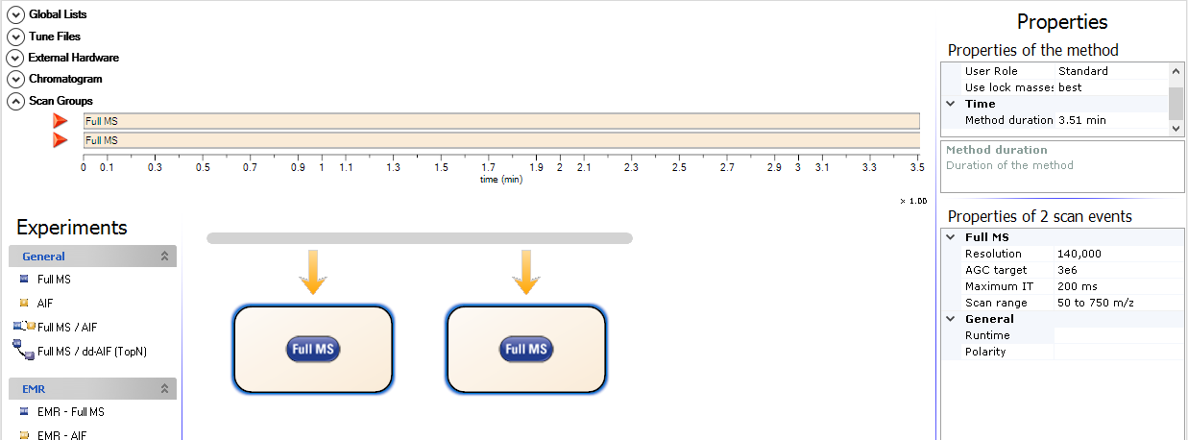
ESI-HRMS using column HypersilGold C18: 50x2.1mm, 1.9μm
Part N. 25002-052130
1mL of MeOH was added in each before injection
H2O +0.1% Formic AC.
ACN +0.1% Formic AC.

Slide 2
▪ Mass spectrometry :
HPLC: ThermoFisher Ultimate3000 with Scientific Vanquish Flex UHPLC
Detector : Vanquish PDA (VF-XX)
ThermoFisher Orbitrap : Exactive Plus with Extend Mass Range: Source HESI II.
Column Reverse Phase : Thermo Fisher HyperGOLDSIL C18: 50x2.1mm, 1.9μm
≤ 5 ppm

Slide 3
0.5 uL of MeOH - blank

Slide 4
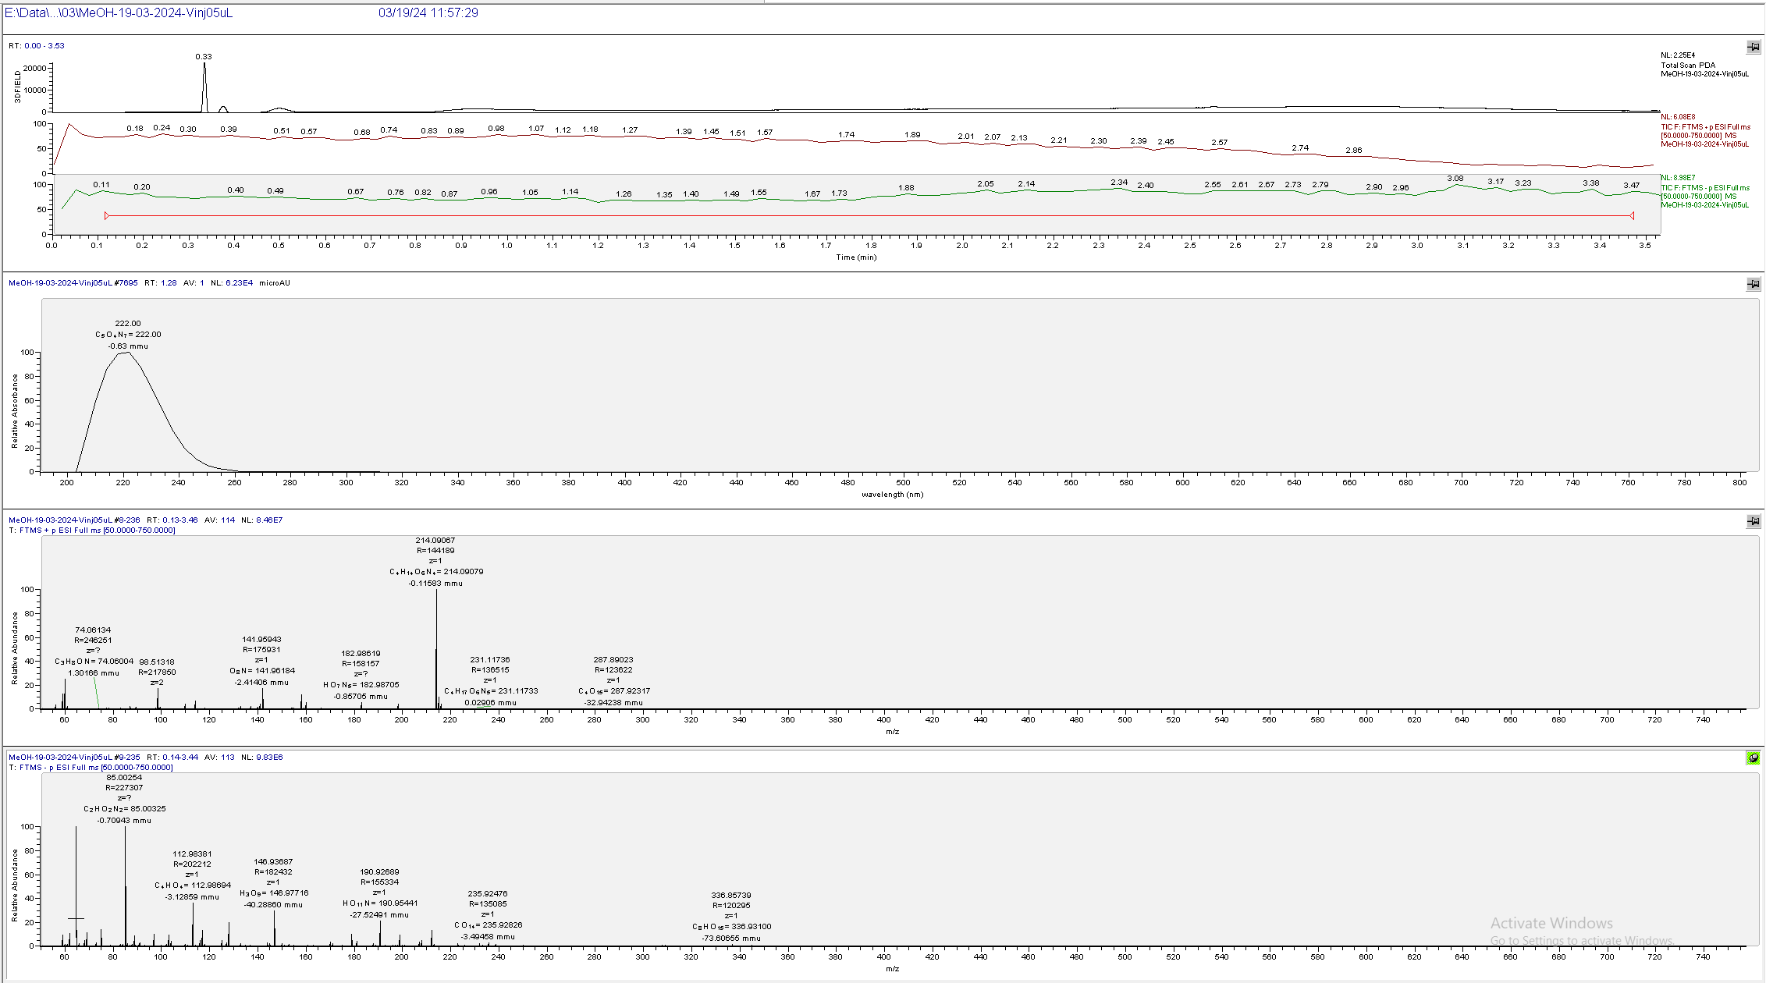
UV
TIC+
TIC-
UV
ESI+
All ions background
ESI-

Slide 5
Compound 2

Slide 6
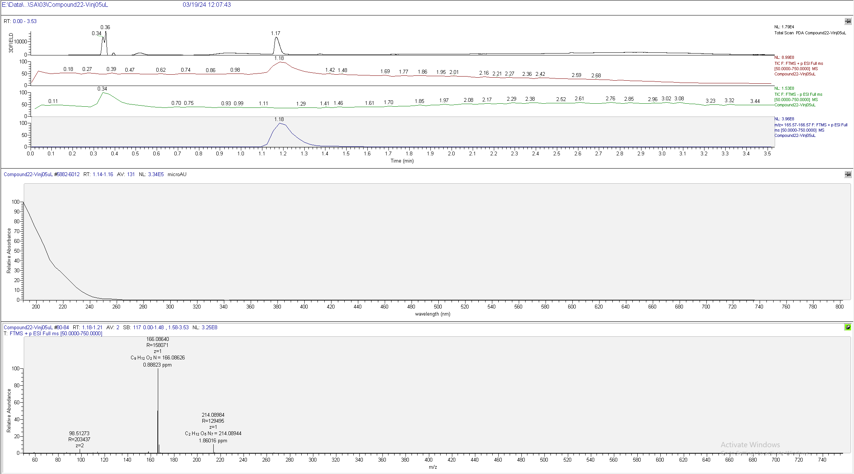

Slide 7
[M+H]⁺
Exp.
Calc.

